Slide 1
Gestão de Recursos Humanos
12
12 - 1

Slide 2
Objetivos
Explicar a importância do processo de Gestão de Recursos Humanos (GRH) e as condicionantes externas que o afetam.
Discutir as tarefas associadas ao recrutamento e seleção de empregados competentes.
Explicar os diferentes tipos de orientação e formação.
Descrever as estratégias para reter os empregados mais competentes, de elevado desempenho.
Discutir assuntos atuais na GRH.
12 - 2

Slide 3
Porque é a GRH ImportantE?
Importante fonte de vantagem competitiva
Uma GRH orientada para as pessoas está associada à criação de um valor superior para os acionistas.
É uma importante ferramenta estratégica
Tratando os empregados como parceiros, a organização consegue ficar um passo à frente da concorrência.
12 - 3
Notes:
HRM is important for three reasons. First, as various studies have concluded, it can be a significant source of competitive advantage. And that’s true for organizations around the world, not just U.S. firms.
Second, HRM is an important part of organizational strategies. Achieving competitive success through people means managers must change how they think about their employees and how they view the work relationship.
Finally, the way organizations treat their people has been found to significantly impact organizational performance. For instance, one study reported that improving work practices could increase market value by as much as 30 percent.

Slide 4
Porque é a GRH ImportantE? (cont.)
Melhora o desempenho organizacional
  Algumas práticas de GRH - práticas de trabalho de elevado desempenho - estão associadas a desempenhos individuais e organizacionais superiores.
12 - 4
Notes:
Work practices that lead to both high individual and high organizational performance are known as high performance work practices.
Even if an organization doesn’t use high-performance work practices, other specific HRM activities must be completed in order to ensure that the organization has qualified people to perform the work that needs to be done—activities that comprise the HRM process.

Slide 5
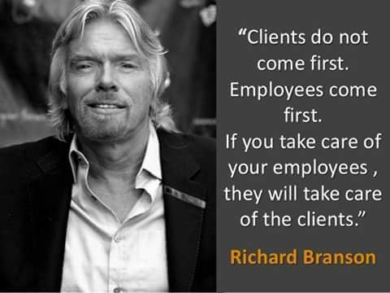

Slide 6
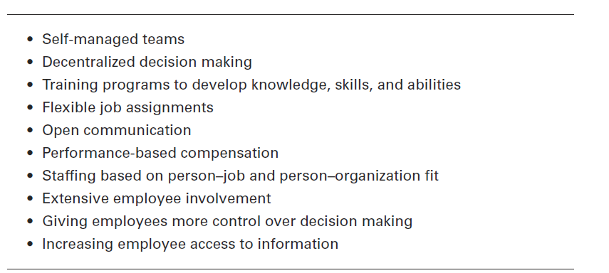
Figura 12-1
Exemplos de práticas de trabalho de elevado desempenho
12 - 5
Notes:
Some examples of high-performance work practices are found in Exhibit 12-1.

Slide 7
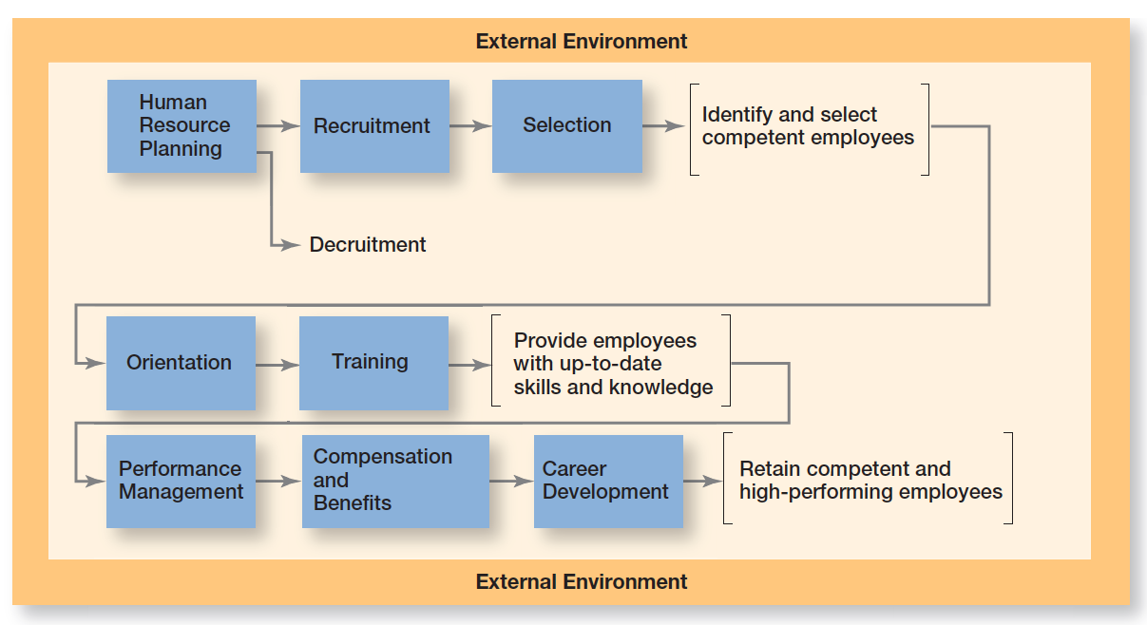
Figura 12-2: o processo de grh
12 - 6
Notes:
Exhibit 12-2 shows the eight activities in the HRM process.

Slide 8
Fatores externos que afetam a GRH
Efeitos da Economia na GRH
  A crise económica global deixou marcas na GRH que muitos especialistas pensam que estão para durar.
  Exemplos: A proporção de contratos sem termo vs. trabalho a termo ou trabalho a recibos verdes; a estabilidade dos empregos; as expectativas de reforma.
12 - 7
Notes:
The entire HRM process is influenced by the external environment. Those factors most directly influencing it include the economy, employee labor unions, governmental laws and regulations, and demographic trends.
The global economic downturn has left what many experts believe to be an enduring mark on HRM practices worldwide. In the United States, labor economists say that although jobs may be coming back slowly, they aren’t the same ones that employees were used to. Many of these jobs are temporary or contract positions, rather than full-time jobs with benefits.

Slide 9
Fatores externos que afetam a GRH (cont.)
Sindicatos de trabalhadores
  Sindicato – organização que representa os trabalhadores e que procura proteger os seus interesses através da negociação coletiva.
  Paragens no trabalho (greves), conflitos laborais e negociações entre gestão e trabalhadores, são apenas alguns dos desafios que os gestores enfrentam perante uma força de trabalho sindicalizada.
12 - 8
Notes:
A labor union is an organization that represents workers and seeks to protect their interests through collective bargaining. In unionized organizations, many HRM decisions are dictated by collective bargaining agreements, which usually define things such as recruitment sources; criteria for hiring, promotions, and layoffs; training eligibility; and disciplinary practices. Work stops, labor disputes, and negotiations between management and labor are just a few of the challenges organizations and managers face when their workforce is unionized.

Slide 10
Fatores externos que afetam a GRH (cont.)
Contexto Legal da GRH
  Contexto legal nacional – Código do trabalho
  http://www.cite.gov.pt/pt/legis/CodTrab_indice.html
12 - 9
Notes:
An organization’s HRM practices are governed by a country’s laws. A number of important laws and regulations affect what you can and cannot do legally as a manager. Because workplace lawsuits are increasingly targeting supervisors, as well as their organizations, managers must know what they can and cannot do by law.
Many U.S. organizations have affirmative action programs to ensure that decisions and practices enhance the employment, upgrading, and retention of members from protected groups such as minorities and females. That is, an organization refrains from discrimination and actively seeks to enhance the status of members from protected groups.
We do want to mention two current U.S. laws that each have the potential to affect future HRM practices. The first of these, the Patient Protection and Affordable Care Act (PPACA; commonly called the Health Care Reform Act), was signed into law in March 2010 and upheld by the Supreme Court of the United States in 2012.
The Social Networking Online Protection Act (SNOPA) has been introduced and would prohibit employers from requiring
a username, password, or other access to online content.

Slide 11
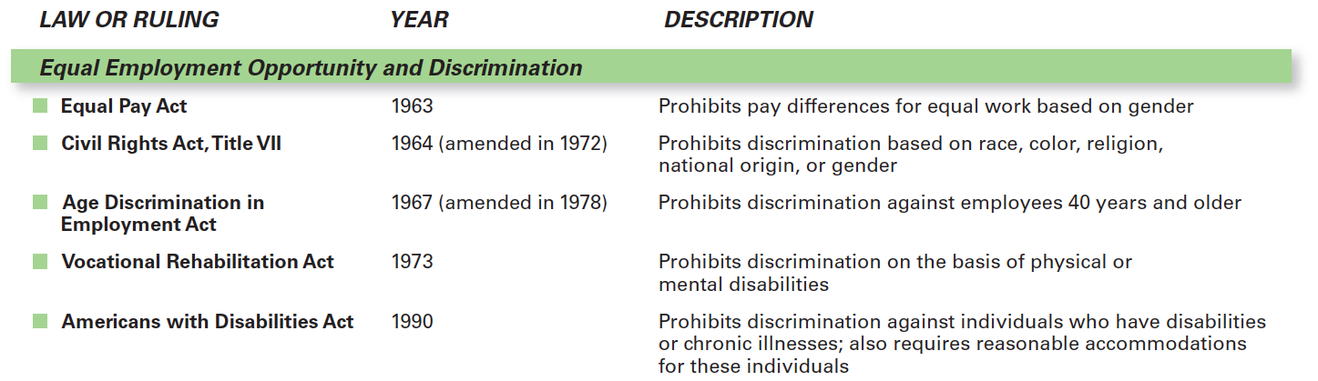
Figura 12-3
Legislação do trabalho nos EUA
12 - 10
Notes:
See Exhibit 12-3 for some of the important U.S. laws that affect the HRM process.

Slide 12
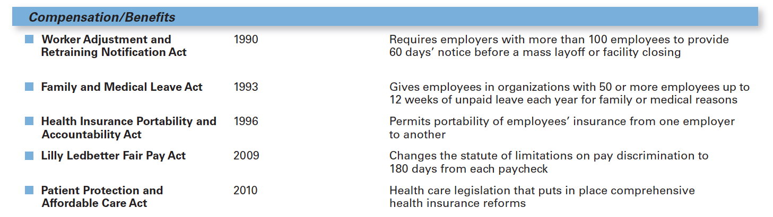
Figura 12-3
Legislação do trabalho nos EUA (cont.)
12 - 11

Slide 13
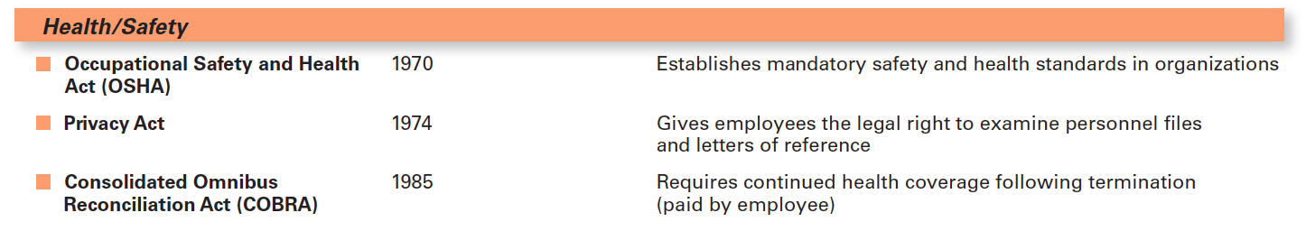
Figura 12-3
Legislação do trabalho nos EUA (cont.)
12 - 12

Slide 14
Fatores externos que afetam a GRH (cont.)
Comissões de trabalhadores
Grupos de trabalhadores que representam os seus colegas dentro das organizações, e que usufruem de direitos especiais de acesso à informação e, em alguns casos tipificados na lei, têm inclusivamente que ser consultados antes da tomada de algumas decisões, por parte da gestão.
12 - 13
Notes:
What about HRM laws globally? It’s important that managers in other countries be familiar with the specific laws that apply there.
In western Europe, the two most common forms of representative participation are work councils and board representatives. Work councils link employees with management. They are groups of nominated or elected employees who must be consulted when management makes decisions involving personnel. Board representatives are employees who sit on a company’s board of directors and represent the interests of the firm’s employees.

Slide 15
Fatores externos que afetam a GRH (cont.)
Representantes dos trabalhadores nos Conselhos de Administração
Empregados que têm lugar no Conselho de Administração e que representam os interesses dos seus colegas.
12 - 13
Notes:
What about HRM laws globally? It’s important that managers in other countries be familiar with the specific laws that apply there.
In western Europe, the two most common forms of representative participation are work councils and board representatives. Work councils link employees with management. They are groups of nominated or elected employees who must be consulted when management makes decisions involving personnel. Board representatives are employees who sit on a company’s board of directors and represent the interests of the firm’s employees.

Slide 16
Fatores externos que afetam a GRH (cont.)
Tendências demográficas
  Envelhecimento da população ativa;
  Coexistência de 4 gerações no Mercado de Trabalho;
  Aumento do nível de escolaridade média;
  Mobilidade de alguns dos melhores RH para os países onde são oferecidas melhores condições de trabalho.
12 - 14
Notes:
Workforce trends in the first half of the twenty-first century will be notable for three reasons: (1) changes in racial and ethnic composition, (2) an aging baby boom generation, and (3) an expanding cohort of Gen Y workers. By 2050, Hispanics will grow from today’s 13 percent of the workforce to 24 percent, blacks will increase from 12 percent to 14 percent, and Asians will increase from 5 percent to 11 percent.
Meanwhile, the labor force is aging. The 55-and-older age group, which currently makes up 13 percent of the workforce, will increase to 20 percent by 2014. Another group that’s having a significant impact on today’s workforce is Gen Y, a population group that includes individuals born from about 1978 to 1994. Gen Y has been the fastest-growing segment of the workforce—increasing from 14 percent to more than 24 percent. With Gen Y now in the workforce, analysts point to the four generations that are working side-by-side in the workplace.

Slide 17
PLAneamento DE RECURSOS HUMANOS
Planeamento de Recursos Humanos – garantir as pessoas “certas”, no número, no sítio e no timing certo.
Análise de funções – avaliação que define as tarefas realizadas numa função e as características que os empregados têm de ter para a sua correta realização.
12 - 15
Notes:
Human resource planning is the process by which managers ensure that they have the right number and kinds of capable people in the right places and at the right times. Through planning, organizations avoid sudden people shortages and surpluses. HR planning entails two steps: (1) assessing current human resources and (2) meeting future HR needs.
An important part of a current assessment is job analysis, an assessment that defines a job and the behaviors necessary to perform it. Information for a job analysis is gathered by directly observing individuals on the job, interviewing employees individually or in a group, having employees complete a questionnaire or record daily activities in a diary, or having job “experts” (usually managers) identify a job’s specific characteristics.

Slide 18
Análise de funções
Descrição da função
Descrição escrita do que implica ter a responsabilidade por aquele trabalho ou função.
Especificações da função
Descrição escrita das qualificações mínimas necessárias, para realizar um determinado trabalho ou função com sucesso.
12 - 16
Notes:
A job description (sometimes called a position description) is a written statement describing a job—typically job content, environment, and conditions of employment.
A job specification states the minimum qualifications that a person must possess to successfully perform a given job. It identifies the knowledge, skills, and attitudes needed to do the job effectively. Both the job description and job specification are important documents when managers begin recruiting and selecting personnel.

Slide 19
Recrutamento e Decruitment
Recrutamento
Localizar, identificar e atrair candidatos capazes.
Decruitment
Reduzir a força de trabalho.
12 - 17
Notes:
If employee vacancies exist, managers should use the information gathered through job analysis to guide them in recruitment—that is, locating, identifying, and attracting capable applicants. On the other hand, if HR planning shows a surplus of employees, managers may want to reduce the organization’s workforce through decruitment.

Slide 20
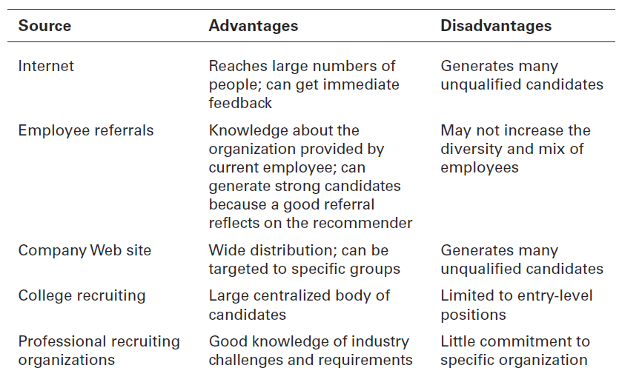
Figura 12-4
Fontes de Recrutamento
12 - 18
Notes:
Exhibit 12-4 explains different recruitment sources managers can use to find potential job candidates.

Slide 21
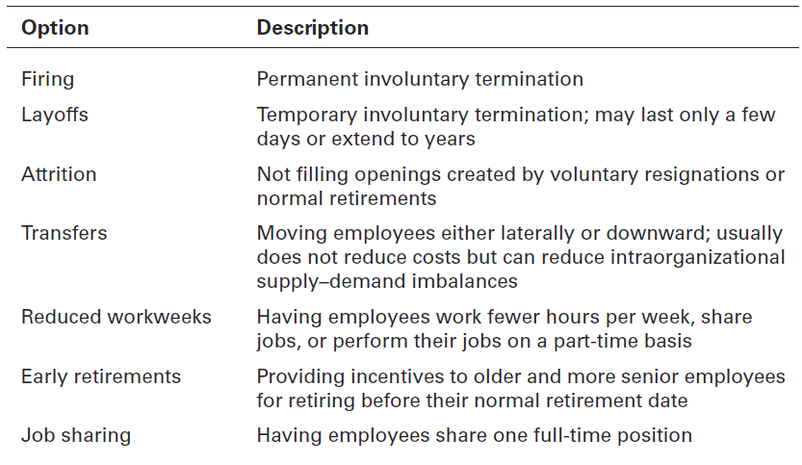
Figura 12-5
Opções de redução de RH (Derecruitment)
12 - 19
Notes:
Decruitment options are shown in Exhibit 12-5.

Slide 22
Seleção
Seleção – análise dos candidatos resultantes do processo de recrutamento, para tentar garantir que são contratadas para a organização as pessoas com mais valor.
O processo de seleção deverá ter subjacente um critério:
Válido (i.e. a relação entre esse critério e o desempenho é a pretendida) e
Fiável (i.e. a variabilidade dos resultados é pequena e não compromete, com frequência, os resultados.)
12 - 20
Notes:
Once you have a pool of candidates, the next step in the HRM process is selection, screening job applicants to determine who is best qualified for the job. Managers need to “select” carefully since hiring errors can have significant implications.

Slide 23
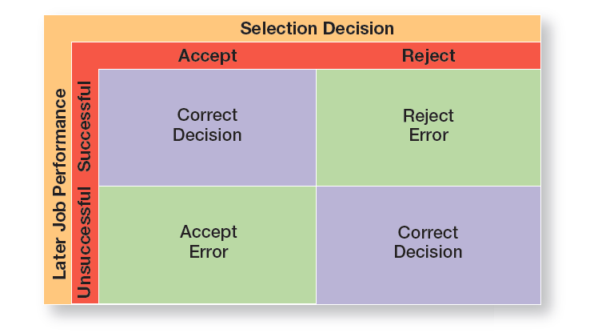
Figura 12-6
Resultados da decisão de seleção
12 - 21
Notes:
As shown in Exhibit 12-6, any selection decision can result in four possible outcomes—two correct and two errors.

Slide 24
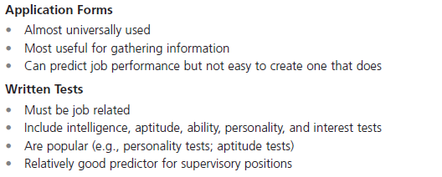
Figura 12-7
Ferramentas de Seleção
12 - 22
Notes:
The best-known selection tools include application forms, written and performance-simulation tests, interviews, background investigations, and in some cases, physical exams. Exhibit 12-7 lists the strengths and weaknesses of each.

Slide 25
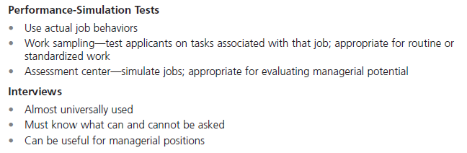
Figura 12-7
Ferramentas de Seleção (cont.)
12 - 23

Slide 26
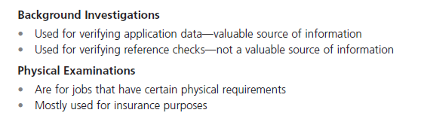
Figura 12-7
Ferramentas de Seleção (cont.)
12 - 24

Slide 27
SeleçÃo (cont.)
Apresentação do trabalho/função de forma realística (realistic job preview)
Apresentação da organização e do trabalho ou função com todas as suas principais características, positivas e negativas.
12 - 25
Notes:
One thing managers need to carefully watch is how they portray the organization and the work an applicant will be doing. If they tell applicants only the good aspects, they’re likely to have a workforce that’s dissatisfied and prone to high turnover.
To increase employee job satisfaction and reduce turnover, managers should consider a realistic job preview (RJP), one that includes both positive and negative information about the job and the company.

Slide 28
Fornecer aos empregados competências e conhecimento
Orientação - introduzir o empregado à sua função e organização.
A formação dos empregados é uma importante atividade da GRH.
Em 2011, as empresas nos E.U.A. gastaram mais de $59 mil milhões em programas de formação dos seus empregados.
12 - 26
Notes:
A person starting a new job needs the same type of introduction to his or her job and the organization. This introduction is called orientation. There are two types of orientation. Work unit orientation familiarizes the employee with the goals of the work unit, clarifies how his or her job contributes to the unit’s goals, and includes an introduction to his or her new coworkers. Organization orientation informs the new employee about the company’s goals, history, philosophy, procedures, and rules. It should also include relevant HR policies and maybe even a tour of the facilities.
Employee training is an important HRM activity. As job demands change, employee skills have to change. In 2011, U.S. business firms spent more than $59 billion on formal employee training. Managers, of course, are responsible for deciding what type of training employees need, when they need it, and what form that training should take.

Slide 29
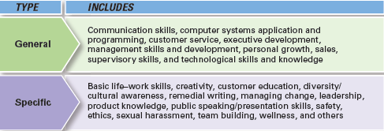
Figura 12-8
Tipos de Formação
12 - 27
Notes:
Exhibit 12-8 describes the major types of training that organizations provide. Some of the most popular types include profession/industry-specific training, management/supervisory skills, mandatory/compliance information (such as sexual harassment, safety, etc.), and customer service training.

Slide 30
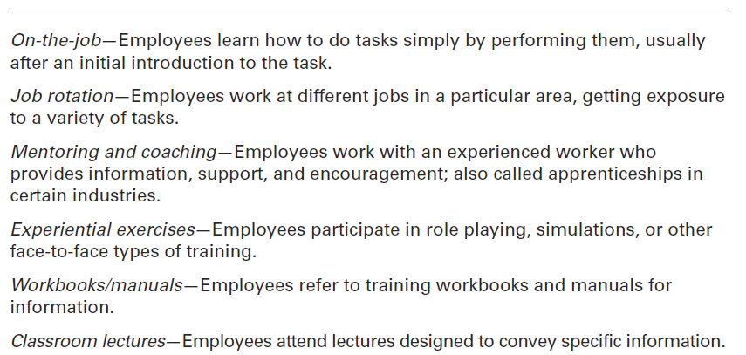
Figura 12-9
Métodos tradicionais de formação
12 - 28
Notes:
Exhibit 12-9 provides a description of the various traditional and technology-based training methods that managers might use. Of all these training methods, experts believe that organizations will increasingly rely on e-learning and mobile applications to deliver important information and to develop employees’ skills.

Slide 31
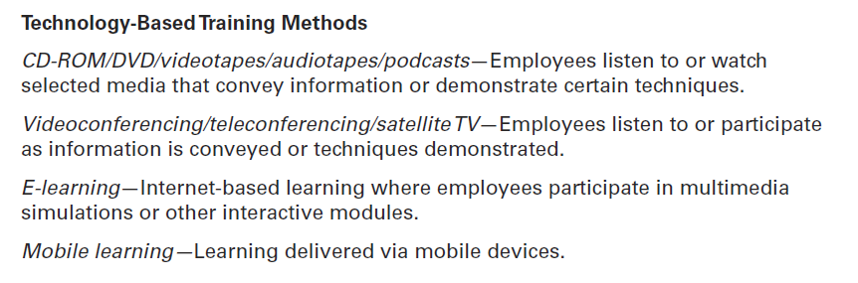
Figura 12-9
Métodos tradicionais de formação (cont.)
12 - 29

Slide 32
Reter empregados competentes e com elevado desempenho
Sistema de Gestão do Desempenho – Define os critérios usados para avaliar o desempenho dos empregados.
Remuneração baseada nas competências – a compensação depende das competências detidas ou evidenciadas pelos empregados.
Remuneração variável – i.e. contingente ao desempenho obtido.
12 - 30
Notes:
A performance management system establishes performance standards used to evaluate employee performance.
More than 70 percent of managers admit they have trouble giving a critical performance review to an underachieving employee.
How do managers determine who gets paid what? Skill-based pay systems reward employees for the job skills and competencies they can demonstrate. Under this type of pay system, an employee’s job title doesn’t define his or her pay category, skills do. Research shows these types of pay systems tend to be more successful in manufacturing organizations than in service organizations and organizations pursuing technical innovations. On the other hand, many organizations use variable pay systems, in which an individual’s compensation is contingent on performance—90 percent of U.S. organizations use some type of variable pay plans, and 81 percent of Canadian and Taiwanese organizations do.

Slide 33
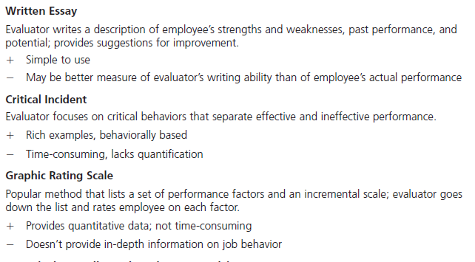
Figura 12-10
Métodos de avaliação de desempenho
12 - 31
Notes:
Although appraising someone’s performance is never easy, especially with employees who aren’t doing their jobs well, managers can be better at it by using any of the seven different performance appraisal methods. A description of each of these methods, including advantages and disadvantages, is shown in Exhibit 12-10.

Slide 34
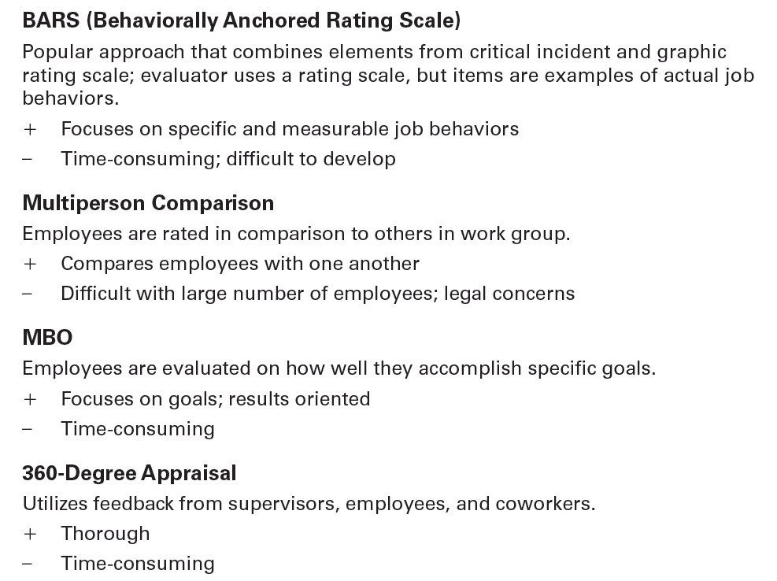
Figura 12-10
Métodos de avaliação de desempenho (cont.)
12 - 32

Slide 35
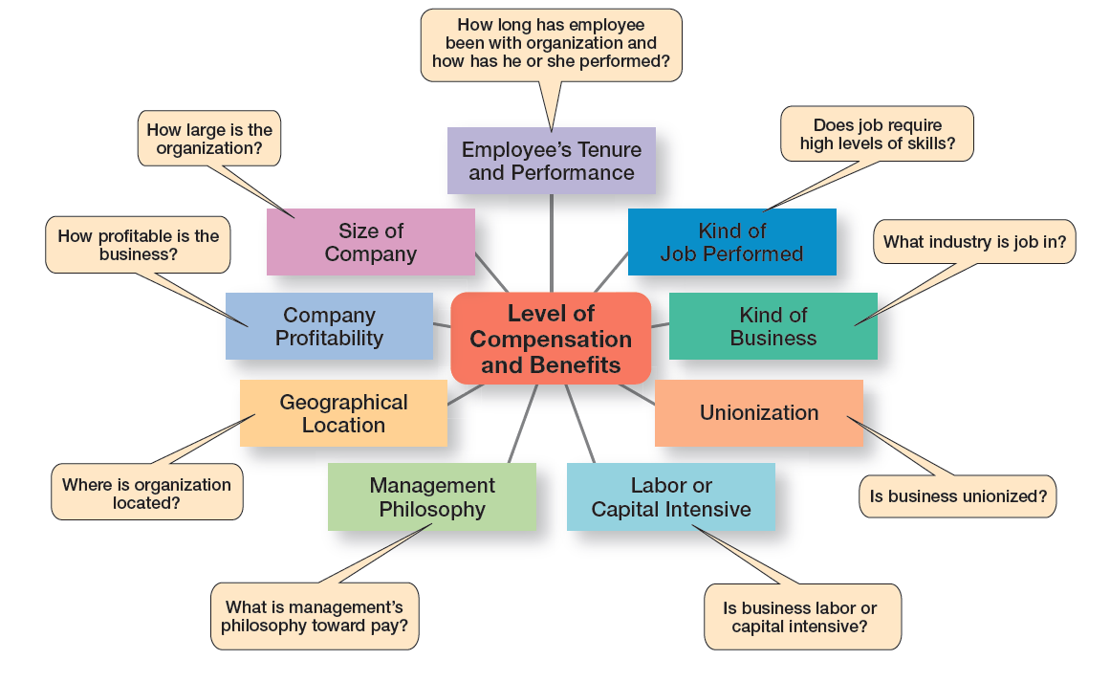
Figura 12-11 o que determina a remuneração e benefícios
12 - 33
Notes:
Exhibit 12-11 summarizes these factors, which are job-based and business-or industry-based.

Slide 36
Assuntos atuais na grh
Downsizing (ou layoffs) - eliminação planeada de postos de trabalho na organização.
Assédio – Assédio é todo o comportamento indesejado, nomeadamente o baseado em fator de discriminação, praticado aquando do acesso ao emprego ou no próprio emprego, trabalho ou formação profissional, com o objetivo ou o efeito de perturbar ou constranger a pessoa, afetar a sua dignidade, ou de lhe criar um ambiente intimidativo, hostil, degradante, humilhante ou desestabilizador.
(Source: http://www.cite.gov.pt/pt/acite/dirdevtrab005.html )
12 - 34
Notes:
Downsizing (or layoffs) is the planned elimination of jobs in an organization. When an organization has too many employees—which can happen when it’s faced with an economic recession, declining market share, too aggressive growth, or poorly managed operations—one option for improving profits is to eliminate some of those excess workers. During the most current economic recession, many well-known companies downsized—including, among others, Boeing, Nokia, Procter & Gamble, Hewlett-Packard, Volkswagen, Dell, General Motors, Unisys, Siemens, Merck, Honeywell, and eBay.
Sexual harassment is a serious issue in both public and private sector organizations. During 2011 (the latest data available), more than 8,300 complaints were filed with the Equal Employment Opportunity Commission (EEOC), a substantial drop from 13,867 in 2008, 12,696 in 2009, and 11,717 in 2010.

Slide 37
Assuntos atuais na grh
Assédio Sexual
Assédio sexual é todo o comportamento indesejado de carácter sexual, sob forma verbal, não verbal ou física, com o objetivo ou o efeito de perturbar ou constranger a pessoa, afetar a sua dignidade, ou de lhe criar um ambiente intimidativo, hostil, degradante, humilhante ou desestabilizador.
(Source: http://www.cite.gov.pt/pt/acite/dirdevtrab005.html )
12 - 34
Notes:
Downsizing (or layoffs) is the planned elimination of jobs in an organization. When an organization has too many employees—which can happen when it’s faced with an economic recession, declining market share, too aggressive growth, or poorly managed operations—one option for improving profits is to eliminate some of those excess workers. During the most current economic recession, many well-known companies downsized—including, among others, Boeing, Nokia, Procter & Gamble, Hewlett-Packard, Volkswagen, Dell, General Motors, Unisys, Siemens, Merck, Honeywell, and eBay.
Sexual harassment is a serious issue in both public and private sector organizations. During 2011 (the latest data available), more than 8,300 complaints were filed with the Equal Employment Opportunity Commission (EEOC), a substantial drop from 13,867 in 2008, 12,696 in 2009, and 11,717 in 2010.

Slide 38
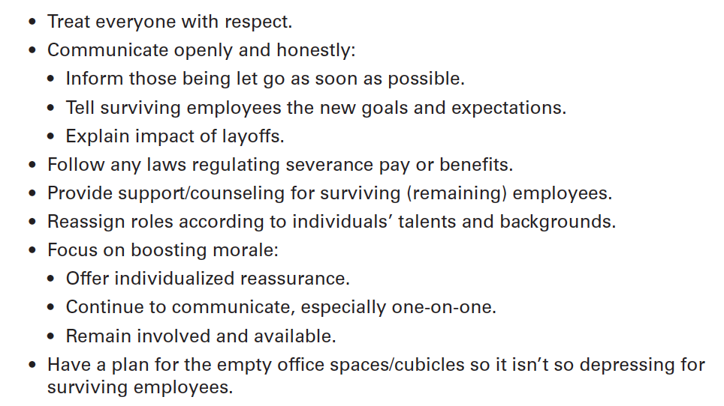
Figura 12-12
Sugestões para gerir um Downsizing
12 - 35
Notes:
Exhibit 12-12 lists some ways that managers can lessen the trauma both for the employees being laid off and for the survivors.

Slide 39

Assuntos atuais na grh (cont.)
Family-friendly benefits
Benefícios que procuram ir de encontro às necessidades de compatibilização da vida fora e dentro do local de trabalho. (work–life balance)
12 - 36
Notes:
Smart managers recognize that employees don’t leave their families and personal lives behind when they come to work. In response, many organizations are offering family-friendly benefits, which accommodate employees’ needs for work–family life balance. They’ve introduced programs such as on-site child care, summer day camps, flextime, job sharing, time off for school functions, telecommuting, and part-time employment.

Slide 40


